Slide 1
Discount Voyage
Yose Indrawan W. (2011730006) | (2011730015) Jeane Satyadi
Kevin Wijaya (2011730023) | (2011730024) Jeremy Razel Suryadi
Yohanes Bella (2011730028) | (2011730045) Calvin Setiawan
Derrick Nathaniel T. (2011730060) | (2011730061) Edbert Jeremiah Samuel
Albert Kamord (2011730077)

Slide 2
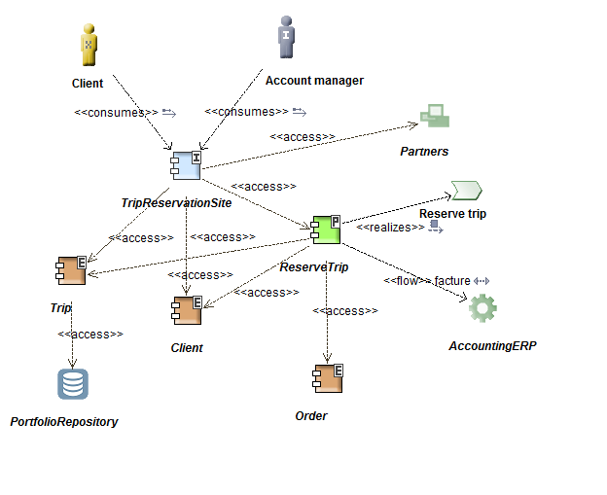
Architecture Vision – Solution Concept Diagram
Customer dapat memesan paket travel melalui website DV.
Informasi pemesanan diteruskan ke bagian financial/accounting dari DV.

Slide 3
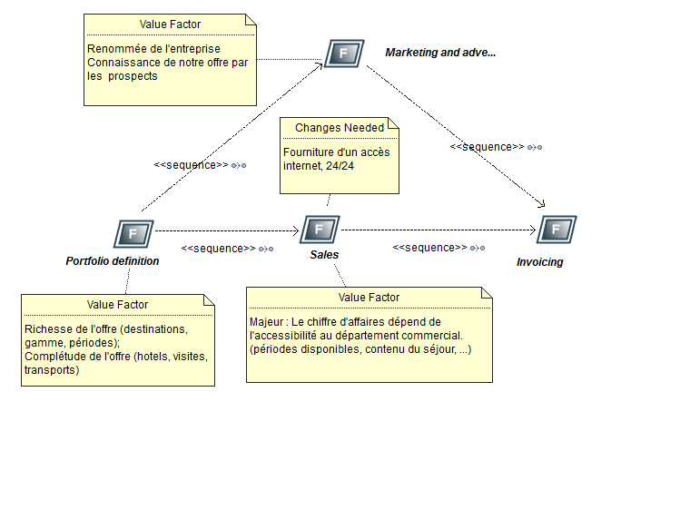
Architecture Vision – Value Chain Diagram

Slide 4
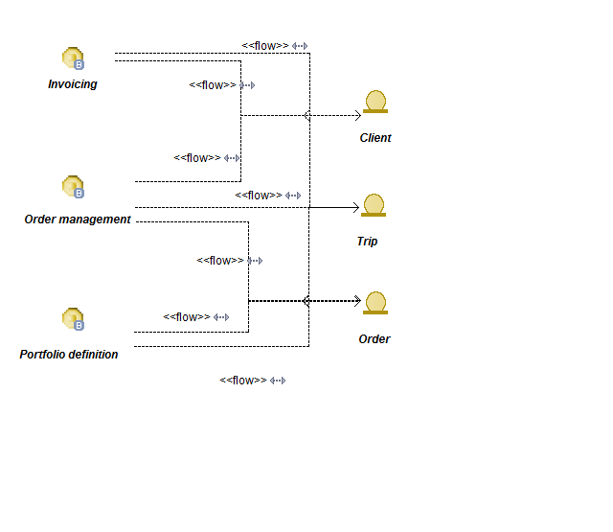
Business Architecture – Business Service Information Diagram
Menunjukkan alur dari data-data Business Service.
Informasi Client didapat dari Invoicing dan Order Management.
Informasi Trip didapat dari Invoicing, Order Management dan Portofolio Definition.
Informasi Order didapat dari Order Management dan Portofolio Definition

Slide 5
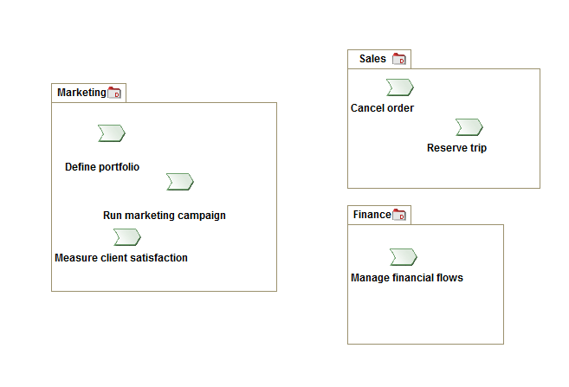
Business Architecture – Event Diagram(Process Map)
Menunjukkan hubungan antar Events dan Processes.

Slide 6
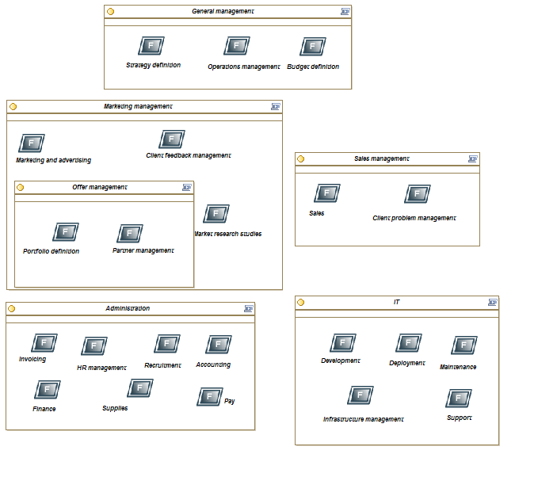
Function Decomposition Diagram

Slide 7
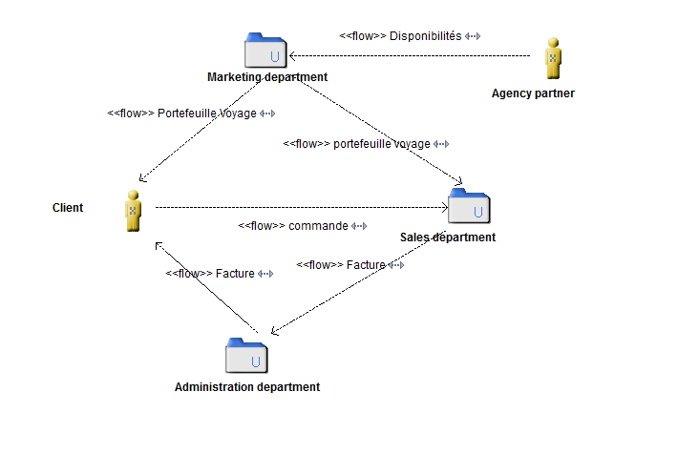
Organization Decomposition Diagram - Flow

Slide 8
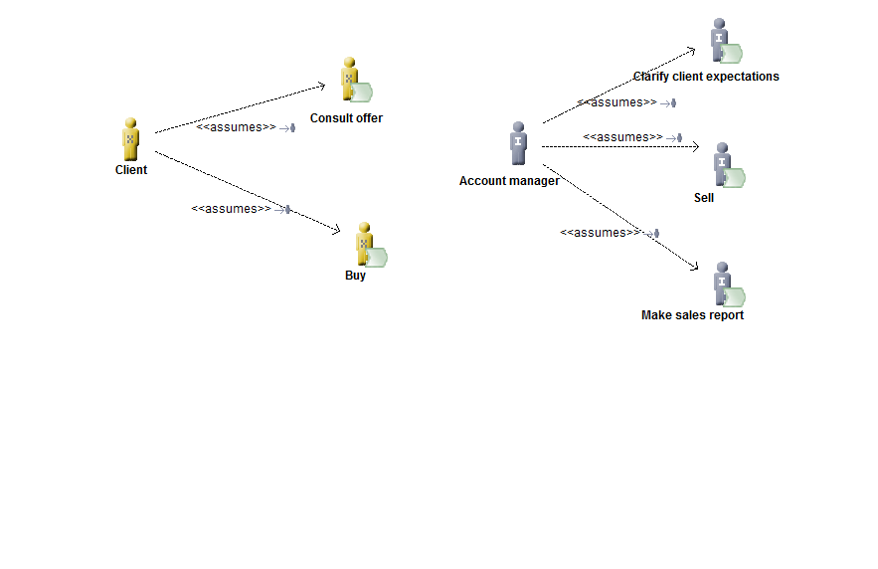
Organization Decomposition Diagram - Role Allocation

Slide 9
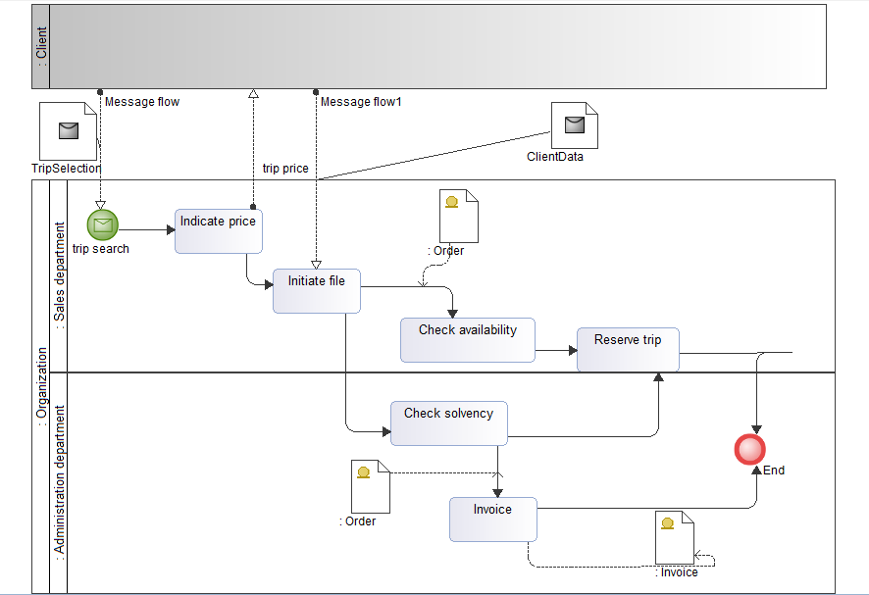
Process Flow Diagram

Slide 10
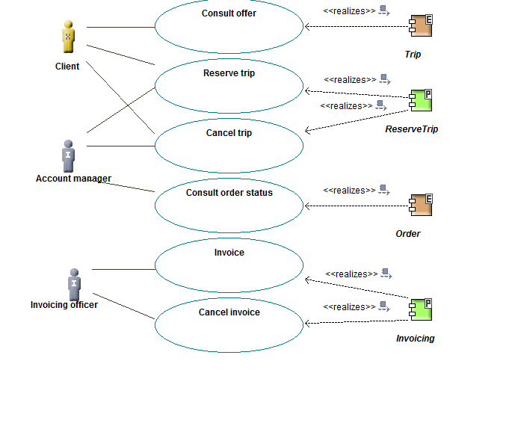
Use Case Diagram

Slide 11
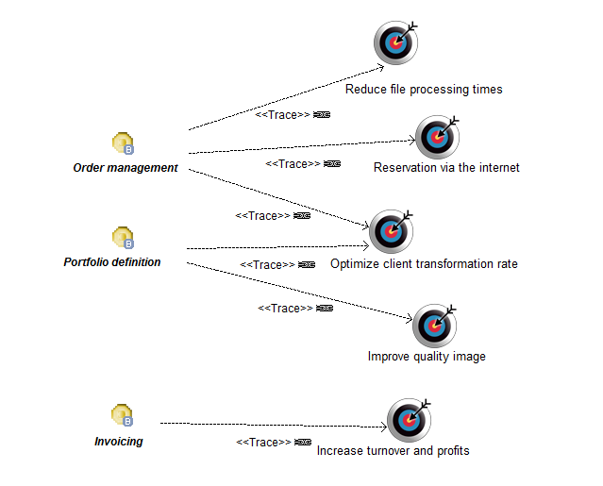
Goal-Object-Service Diagram

Slide 12
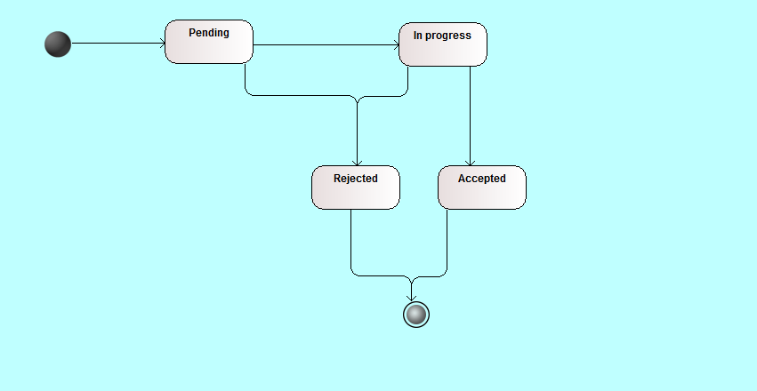
Lifecycle Diagram

Slide 13
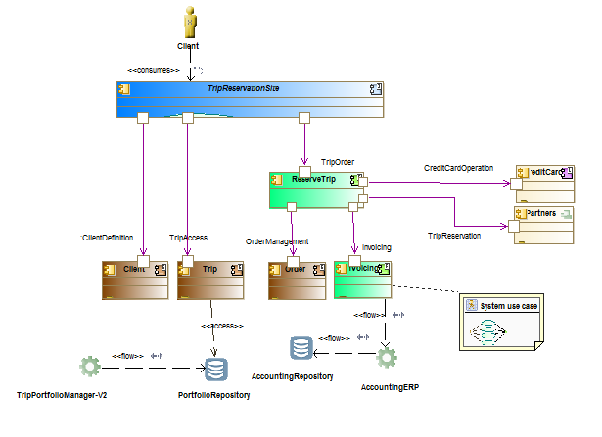
Fase C - IS - Application
Application
Communication
Diagram

Slide 14
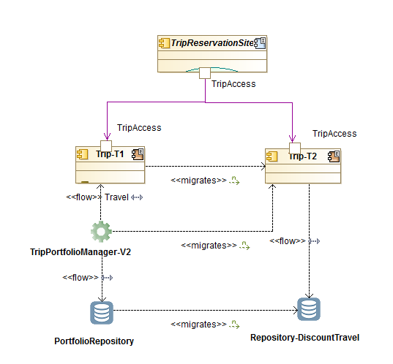
Enterprise Manageability Diagram

Slide 15
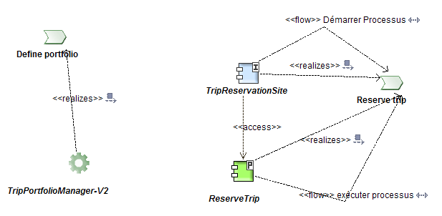
Process/System Realization Diagrams

Slide 16
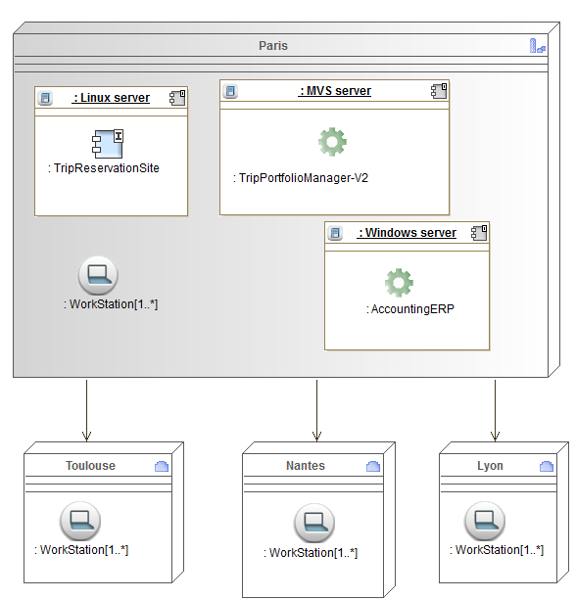
Fase D – Technology Architecture
Environments and Locations Diagram

Slide 17
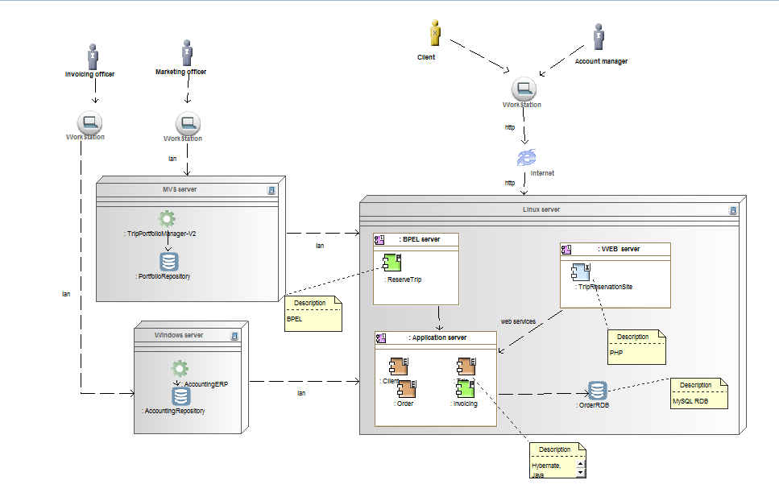
Network Computing and Hardware Diagram

Slide 18
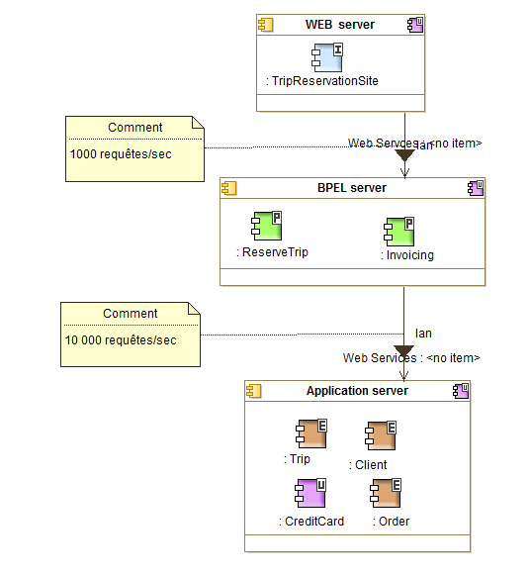
Processing Diagram

Slide 19
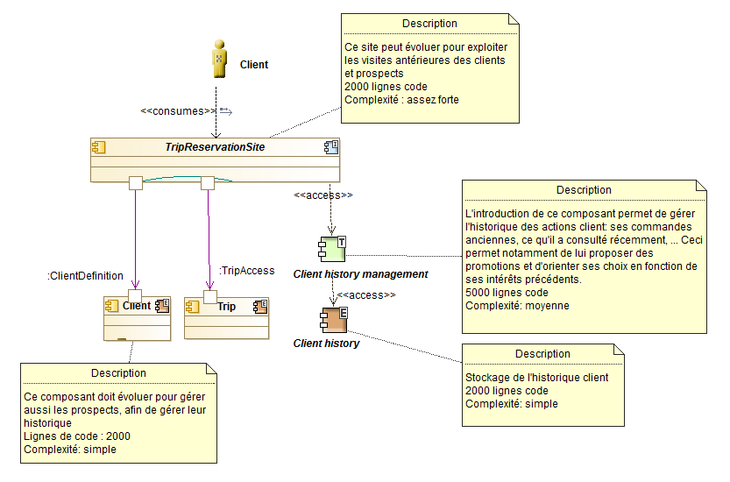
Fase E – Oportunities and Solutions
Benefits Diagram

Slide 20
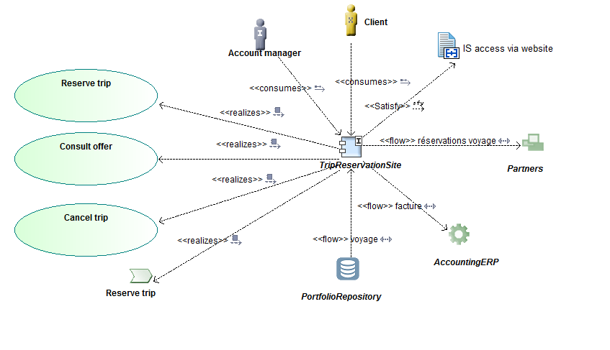
Project Context Diagram

Slide 21
Thank You

